Slide 1


Government Polytechnic, Khamgaon
JOB FINDING WEBSITE
Submitted by:
Guided By :
1. Tanavi Narkhede (32)
2. Kaushal Khachane (35)
3. Amarbirsingh Randhawa (40)
4. Vaishnavi Chopade (67)
Prof. S. V. Paranjape
Notes:
Source File:
https://unsplash.com/photos/qwv8C2SDTq4

Slide 2

CONTENTS
Introduction
Existing System
Aim of Project
Design Methodology
Advantages
Software Requirements
References
Job Finding Website
Notes:
Source File:
https://unsplash.com/photos/nISqmehpBQk

Slide 3

Introduction
User Based Problem :- At past for job finding, employee did not have any such platform to search job.
A job finding website is a type of website that deals specifically with employment and careers.
Many such websites allow employers to post their job requirements for a needed post.
Such sites can help candidates with any education and experience level to find employment in any sector.
Job Finding Website
Notes:
Source File;
https://unsplash.com/photos/EhTcC9sYXsw

Slide 4

Existing System
This isn't a first portal to find a job, there are numerous similar platform formerly developed.
The being job searching website has numerous feature.
Such as linkedin, Indeed, Naukari, etc.
2022
5
Job Finding Website
Notes:
Source:
https://unsplash.com/photos/GkraTrCYA_0

Slide 5

Aim Of Project
The Aim of this Project is we try to develop job Finding
website at our own using java servlet.
Student Module
Company Module
2022
6
Job Finding Website
Notes:
Source:
https://unsplash.com/photos/GkraTrCYA_0

Slide 6





Methodology
In this project we are going to use front end as HTML, CSS and Bootstrap for designing.
As a backend we use Java and MySQL.
For server side we use Java Servlet and JSP.
7
Job Finding Website
Notes:
Source File;
https://unsplash.com/photos/gMsnXqILjp4

Slide 7
Advantages
User friendly
1
User interface will be simple and easy to understand.
Cost-effective
If you manage your campaign effectively, you can save plenty of precious cash
4
Job Finding Website
2
Filters
Provide the option of applying the filters for the job search.
Information
3
Provide you the details related to the vacancies that are present in various parts of the world.
Job Finding Website

Slide 8
Disadvantages
It could lead to
lost labour hours
1
It attracts bad candidates
4
Job Finding Website
2
It can affect communication
There’s a lot of competition
3
Job Finding Website

Slide 9
Features
Job Alerts
1
Applicant Tracking
2
Job Finding Website
3
Search Functionalities
Job Finding Website

Slide 10
Database Tables
Our project uses MySQL as the backend database, to store and retrieve data to / from the table.
In the workbench, a database named “job” has been created, which contains 3 basic tables:
“student” – To store the students’ information who have signed up on the website.
“company” – To store all the companies information like name, branch address, vacant jobs, etc
Job Finding Website
Name | Phone | Email | Dob | Password
name | city | address | jobs | qualification | expertise | experience | password | link
Job Finding Website

Slide 11
Database Tables
“members” – To store the employee’s information whose job application is approved by the company.
Also contains 25 tables, each company having its own one, to store their respective applicants’ information. This data gets stored when the user fills in his details and applies for any company.
Company tables: infosys, 3i_infotech, wipro, google, hcl_technologies, etc.
Name | Phone | Email | Dob
Job Finding Website
s_name | s_phone | s_email | s_dob | s_qualification | s_expertise | s_experience
Job Finding Website

Slide 12
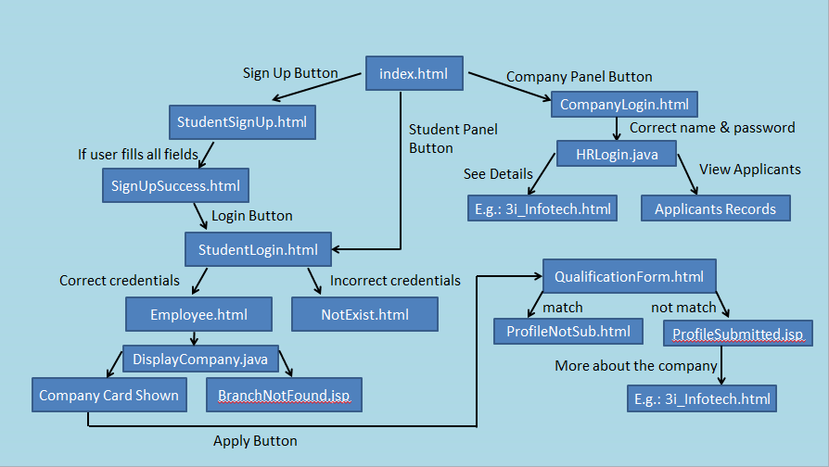
Hierarchy
Job Finding Website
Job Finding Website

Slide 13
Operating System: Windows or Linux.
Front End: HTML, CSS, Bootstrap, JavaScript.
Programming Language: Java.
API: JDBC, Servlet and JSP.
IDE: Eclipse IDE for Enterprise Java and Web Developers.
Database: MySQL.
Server Deployment: Apache Tomcat.
Software Requirements
9
Job Finding Website

Slide 14
REFERENCES
https://business.linkedin.com/
https://www.naukri.com/
https://www.w3schools.com/bootstrap/
https://www.codebun.com/
10
Notes:
You can safely remove this slide. This slide design was provided by SlideModel.com – You can download more templates, shapes and elements for PowerPoint from http://slidemodel.com/

Slide 15

Thank You !
Notes:
Source File;
https://unsplash.com/photos/QGr6H7pri-Q

